Slide 1


BEST STATE-OF-THE-ART MODELS FOR SEMANTIC SEGMENTATION PROBLEMS AND THEIR ABILITIES AND LIMITATIONS
Angelika Żyła

Slide 2

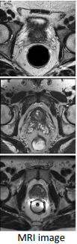


DATASET
Amos: A large-scale abdominal multi-organ benchmark for versatile medical image segmentation.
Creator: JI YUANFENG1

Slide 3
Amos: A large-scale abdominal multi-organ benchmark for versatile medical image segmentation. AMOS large-scale clinical dataset for abdominal organ segmentation. AMOS provides 500 CT scans and 100 MRI scans collected from multi-center, multi-vendor, multi-modality, multi-phase and multi-disease patients, each with voxel-level annotations of 15 abdominal organs, providing challenging examples and a testbed for exploring robust segmentation algorithms within different goals and scenarios. In addition to providing the labeled 600 CT and MRI scans, we expect to provide 2000 CT and 1200 MRI scans without labels to support more learning tasks (semi-supervised, un-supervised) [1].

Slide 4


MA-SAM: MODALITY-AGNOSTIC SAM ADAPTATION FOR 3D MEDICAL IMAGE SEGMENTATION
CHENG CHENA, JUZHENG MIAOB, DUFAN WUA, ZHILING YANC, SEKEUN KIMA, JIANG HUA, AOXIAO ZHONGD,A, ZHENGLIANG LIUE, ALICHAO SUNC, XIANG LIA, TIANMING LIUE, PHENG-ANN HENGB, QUANZHENG LIA

Slide 5
SAM is a promptable segmentation architecture consisting of three main components, i.e., the image encoder, the prompt encoder, and the mask decoder. The image encoder employs the Vision Transformer (ViT) as the backbone, extracting essential features of the images with a set of transformer blocks. The prompt encoder takes in various types of prompts including points, boxes, or texts, and encodes these inputs into prompts embeddings to facilitate the segmentation task. The mask decoder is designed to be lightweight, which computes the cross-attention between embeddings of image and prompts, and utilizes transposed convolutional layers and multilayer perception to generate segmentation masks. When applying to medical images, the model’s performance largely degrades since medical images present distinct texture and objects from natural images. This highlights the necessity for task specific fine-tuning of SAM to address such challenges [2,3,4].

Slide 6
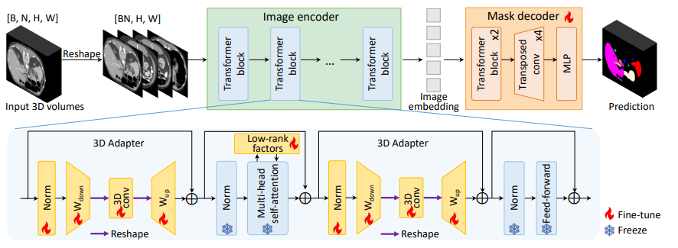
MA-SAM MODEL
Fig. 1: The overview of modality-agnostic SAM adaptation framework (MA-SAM) for medical image segmentation [2]

Slide 7
Fiure present the overview of modality-agnostic SAM adaptation framework (MA-SAM) for medical image segmentation. The image encoder is updated through a parameter-efficient fine-tuning strategy with FacT. The volumetric or temporal information is effectively incorporated via a set of 3D adapters. The mask decoder is fully fine-tuned and modified to recover the prediction resolution. Reshape operations are used to make 3D operations compatible with the 2D backbone.
[2].

Slide 8
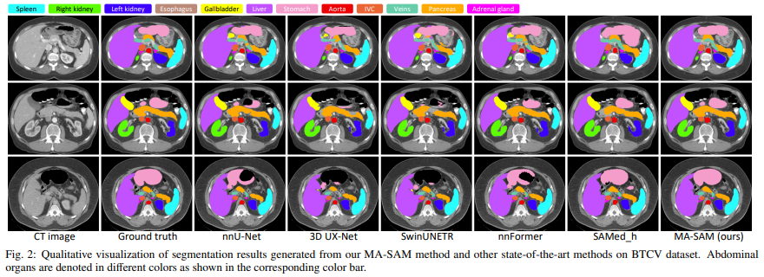
RESULT
Fig. 2: Qualitative visualization of segmentation results generated from MA-SAM method and other state-of-the-art methods on BTCV dataset. Abdominal organs are denoted in different colors as shown in the corresponding color bar [2]

Slide 9
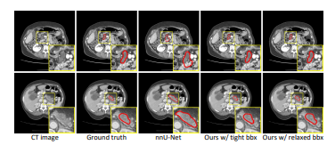
RESULT
Fig. 3: Qualitative visualization of segmentation results generated from our MA-SAM method and other state-of-the-art methods on prostate MRI datasets [2]

Slide 10
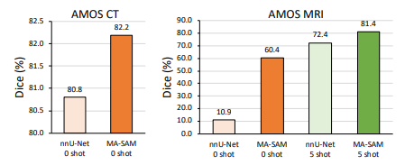
RESULT
Fig. 4: Comparison of zero-shot and five-shot generalization performance of nnU-Net and our MA-SAM model on AMOS CT and MRI data [2]

Slide 11
SUMMARY
Qualitative visualization of segmentation results generated from our MA-SAM method and other state-of-the-art methods on BTCV dataset. Abdominal organs are denoted in different colors as shown in the corresponding color bar.
Qualitative visualization of segmentation results generated from different methods for pancreas tumor segmentation.
Comparison of zero-shot and five-shot generalization performance of nnU-Net and our MA-SAM model on AMOS CT and MRI data [2].

Slide 12
BIBLIOGRAPHY
[1] Amos: A large-scale abdominal multi-organ benchmark for versatile medical image segmentation.
Creator: JI YUANFENG1
[2] MA-SAM: Modality-agnostic SAM Adaptation for 3D Medical Image Segmentation
Cheng Chena, Juzheng Miaob, Dufan Wua, Zhiling Yanc, Sekeun Kima, Jiang Hua, Aoxiao Zhongd,a, Zhengliang Liue, aLichao Sunc, Xiang Lia, Tianming Liue, Pheng-Ann Hengb, Quanzheng Lia, https://doi.org/10.48550/arXiv.2309.08842
[3] Zhang, K., Liu, D., 2023. Customized segment anything model for medical image segmentation. arXiv preprint arXiv:2304.13785 .
[4] Zhang, L., Liu, Z., Zhang, L., Wu, Z., Yu, X., Holmes, J., Feng, H., Dai, H., Li, X., Li, Q., et al., 2023. Segment anything model (sam) for radiation oncology. arXiv preprint arXiv:2306.11730 .

Slide 13
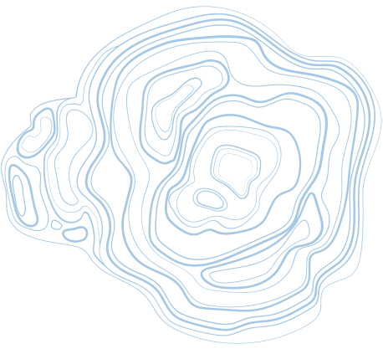





Thank You

